Slide 1
Autonomous Subway Inspection Vehicle
Phase
4
Senior Design
Omar Aziz, Noah Bolzoni, Brandon Castro,
Anthony Lucero, Sean Maggio, Marcin Wisniowski
Advised By Professor Connington
February 27th, 2020

Slide 2
Outline
Alpha & Beta
Demo
A
B
1
2
3
4
Background
Technical Analysis
Engineering Design
Moving Forward

Slide 3
Background
1

Slide 4
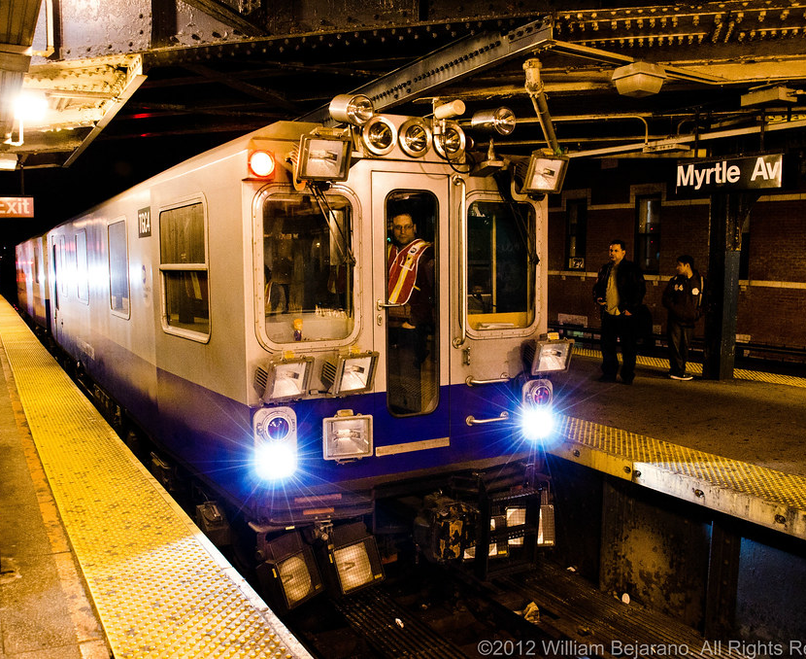
Background
The New York Subway has been around since 1904
5.7 million ride subway everyday
Daily wear and weather elements affect the rails
Weekly inspections needed for mainline track
Reactive inspection and maintenance leads to high costs
2

Slide 5
Project Overview
Cannot rebuild network, must maintain and slowly improve
In New York, geometry trains run non-stop with employees monitoring the rails but only fully inspect a few times per year
3

Slide 6
Project Overview
Autonomous vehicle to collect key track data
More frequent, non-intrusive inspections
Increase subway revenue, efficiency, and safety
4

Slide 7
Design Rationale
MTA capital plan includes hundreds of millions poured into CBTC, communication-based train control
With this, trains can pinpoint exactly where other trains are, and autonomy can be achieved in the near future
5

Slide 8
Design Rationale
A smaller and cheaper inspection vehicle has yet to ever be implemented and can prove to be beneficial for consistent measurement scenarios
6

Slide 9
Technical Analysis
2

Slide 10
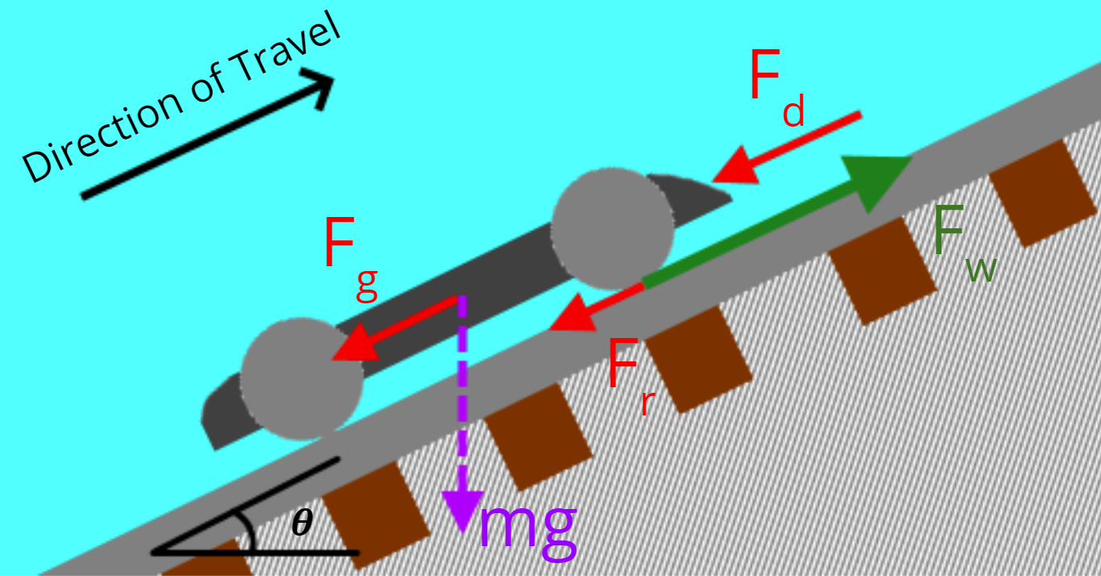
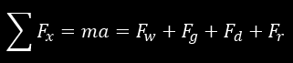
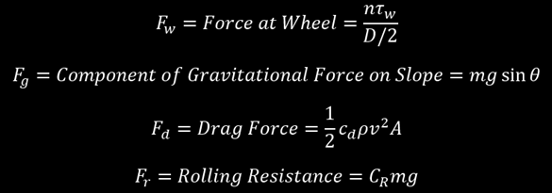
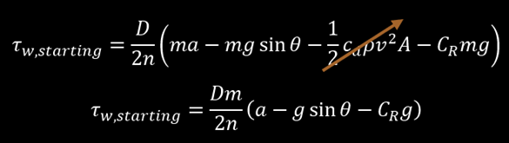
Revised Motor Analysis
Acceleration from rest requires:
High Torque
High Current Draw
8

Slide 11
Revised Motor Analysis
Target values were selected for normal operation and a “reduced” value for use when subject to a considerable gradient
Target | Alpha Prototype | Beta Prototype
Normal Operating Velocity | 5 mph | 10 mph
Normal Acceleration | 0.2 m/s² | 0.2 m/s²
Reduced Velocity | 2.5 mph | 5 mph
Reduced Acceleration | 0.0667 m/s² | 0.0667 m/s²
Gradient | 20 mm/m | 20 mm/m
9

Slide 12
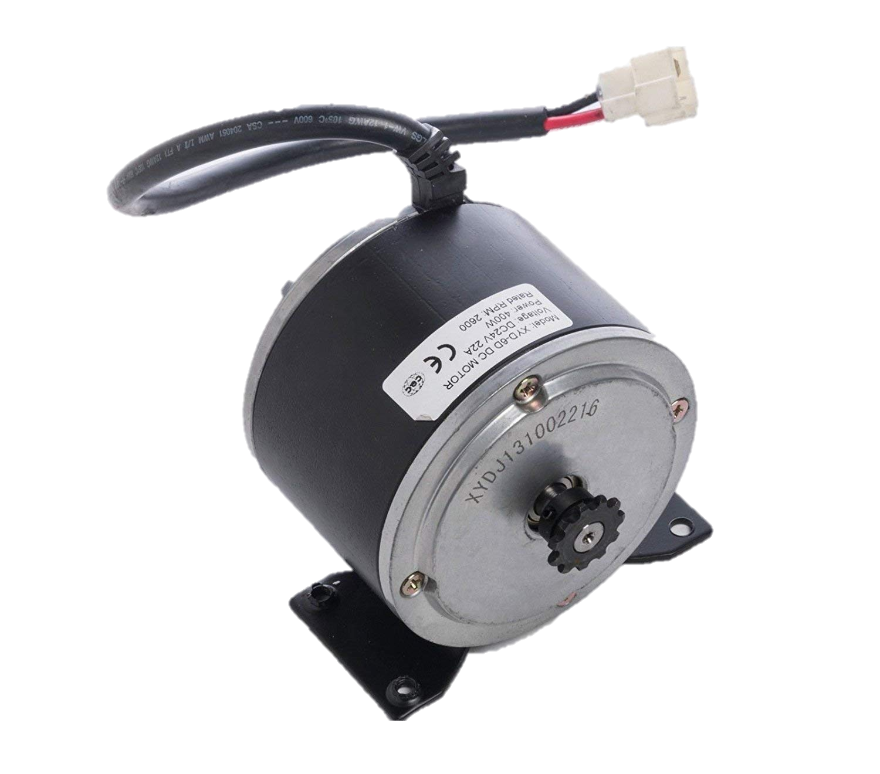
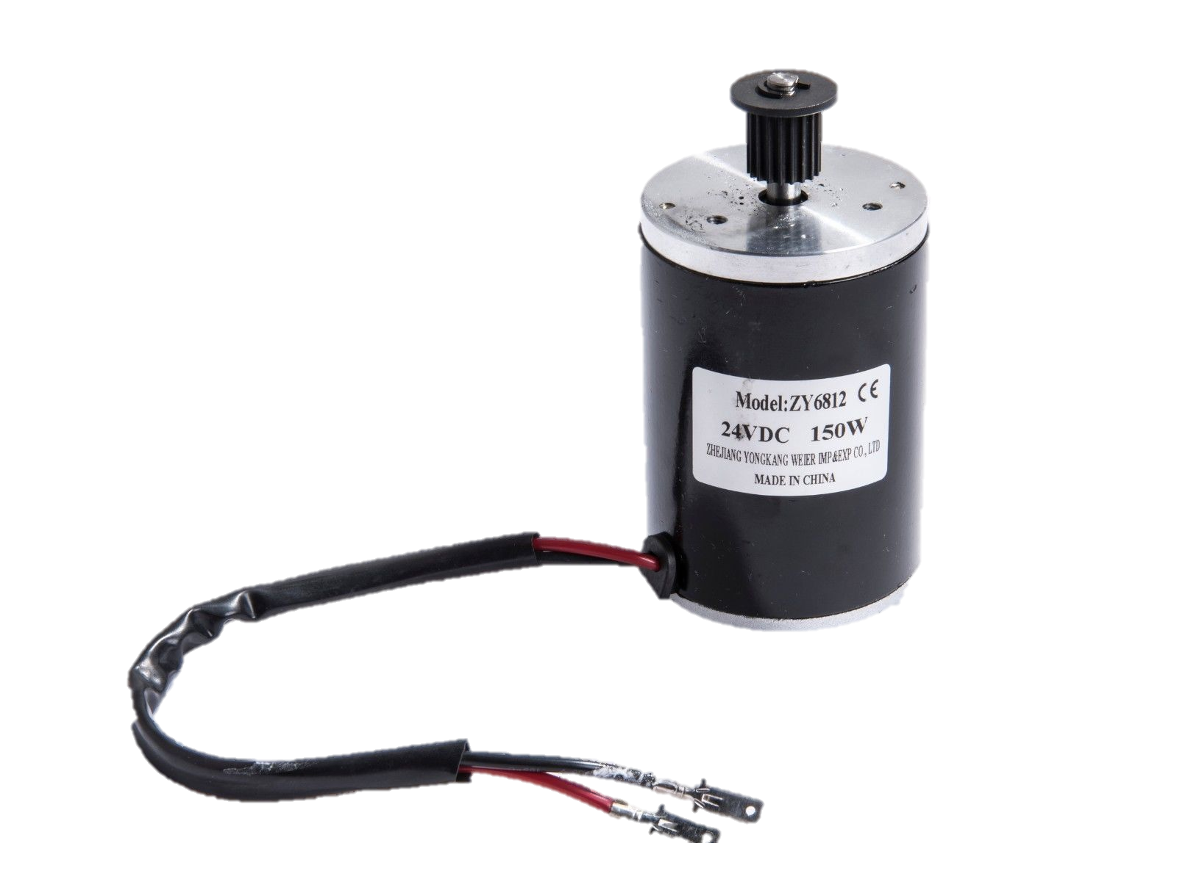
Revised Motor Analysis
Alpha
1x 400-Watt motor
Powering single axle
Rated at ~1 Nm torque
Max 22A
Beta
2x 150 Watt Motors
Powering two independent axles
Rated at 0.52 Nm torque
Max 9.6A
10

Slide 13
Revised Motor Analysis
Calculated Value | Alpha Prototype | Beta Prototype
Starting Torque Uphill | 1.039 Nm | 0.5196 Nm
Starting Torque on Level Track | 0.8082 Nm | 0.4041 Nm
Torque Uphill at Constant Speed | 0.8300 Nm | 0.4690 Nm
Torque on Level Track at Constant Speed | 0.2161 Nm | 0.3239 Nm
Calculations based on similar mechanical characteristics for both prototypes
11

Slide 14
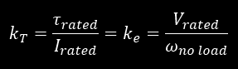
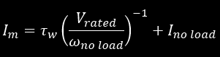
Revised Motor Analysis
Calculated Value | Alpha Prototype | Beta Prototype
Starting Current Uphill | 13.79 A | 8.734 A
Starting Current on Level Track | 11.17 A | 6.971 A
Current at Constant Speed | 11.42 A | 7.962 A
Current on Level Track at Constant Speed | 4.451 A | 5.746 A
Current derived from motor torque voltage constant
12

Slide 15
Measurement and Control
Outputs and functions:
Data collection at fixed intervals (odometer)
SD card write of measurements w/ time & location to CSV(Excel)
Evasion mechanism with detection, retraction, extension
User inputs
Speed and direction control
Variable throttle
Data collection on/off
Evasion trigger (testing)
Wireless Arduino - Arduino communication
May first operate using extended wire connections
13

Slide 16
Additional Functionality
Long range proximity sensors on front and rear
Stop if object detected
Movement away from approaching object
Evasion triggered by forward and rear proximity sensors
Three data collection modes
Time interval
Distance interval
Instantaneous measurement (manual)
3D mapping of rails
Calculate rails as series of coordinates using IMU and gauge
MATLAB display, onboard or using saved coordinates
14

Slide 17
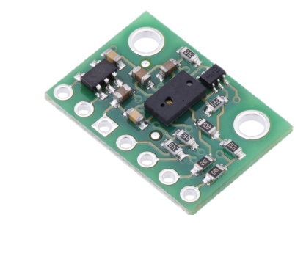
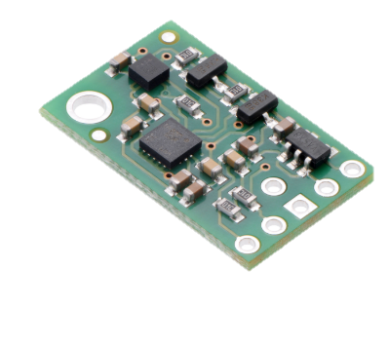
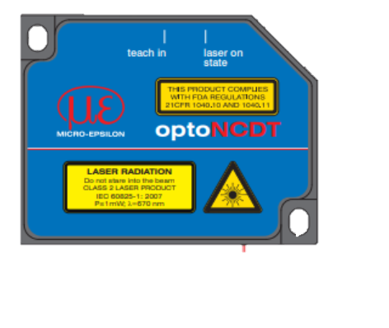
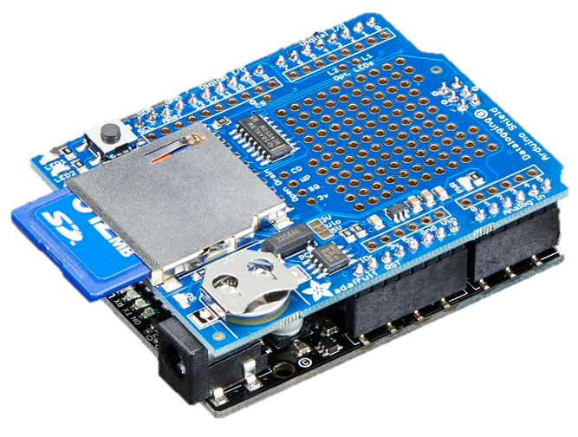
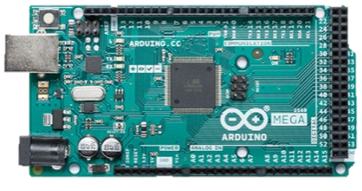
Hardware
VL1680X IR ToF
minIMU v5
optoNCDT 1402
Adafruit DataLogger Shield
15
Arduino Mega

Slide 18
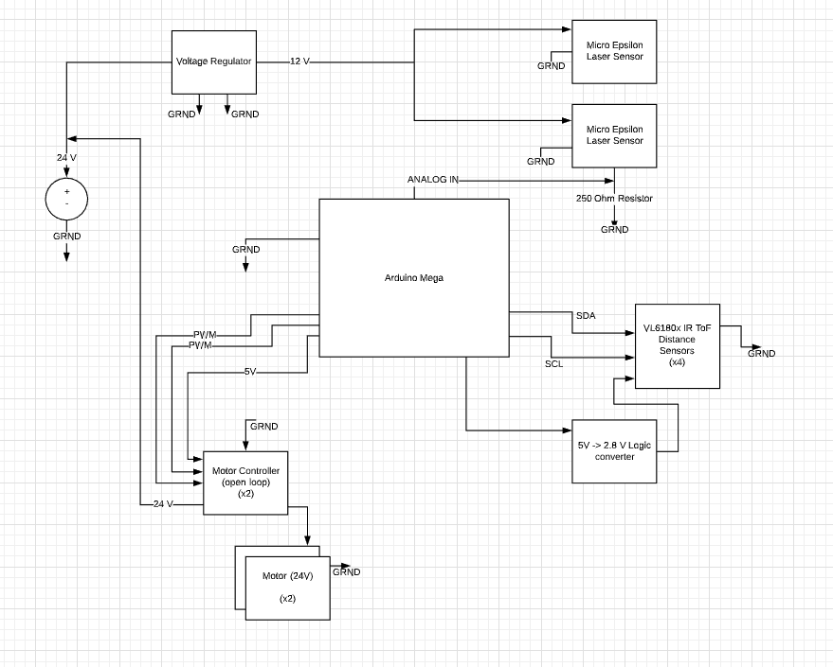
Electrical System Architecture
16

Slide 19
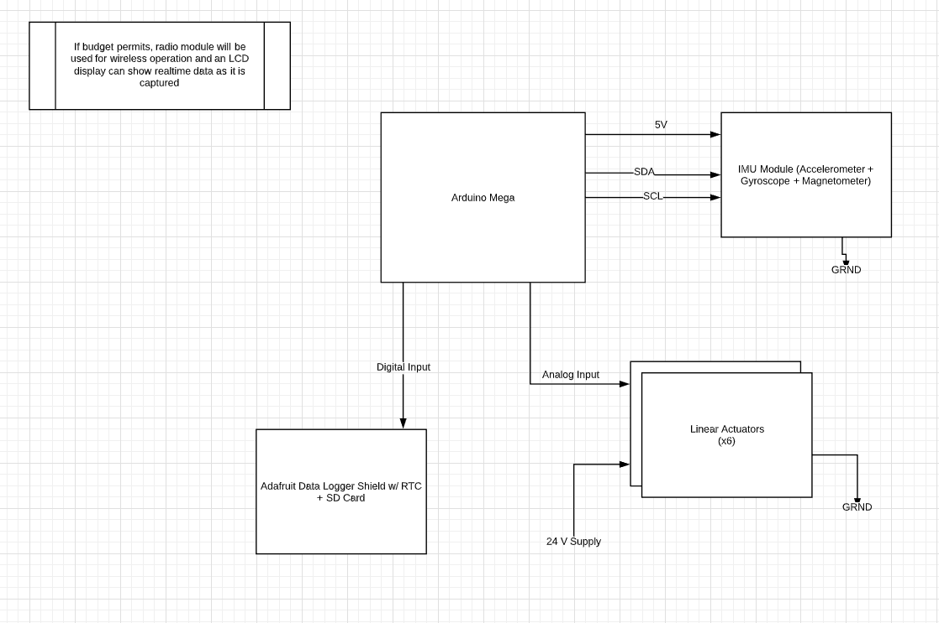
Electrical System Architecture
17

Slide 20
System Integration
Test items separately
Ex: learn to use RTC, then learn to use write to SD, then combine
Integrate individual items and functions in full software architecture
18

Slide 21
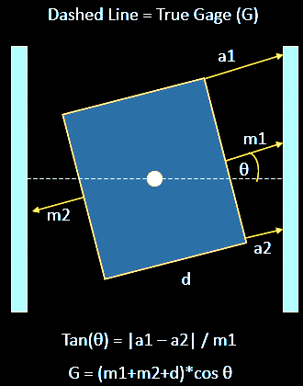
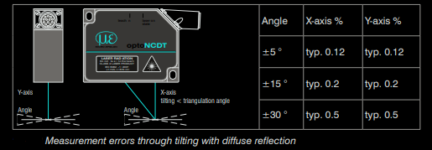
Errors
19

Slide 22
Engineering Design
3

Slide 23
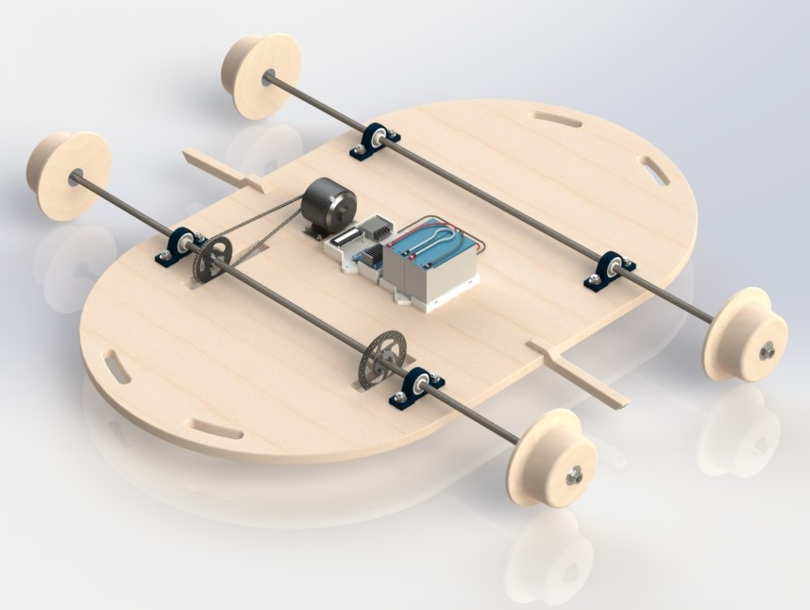
Alpha Prototype
20

Slide 24
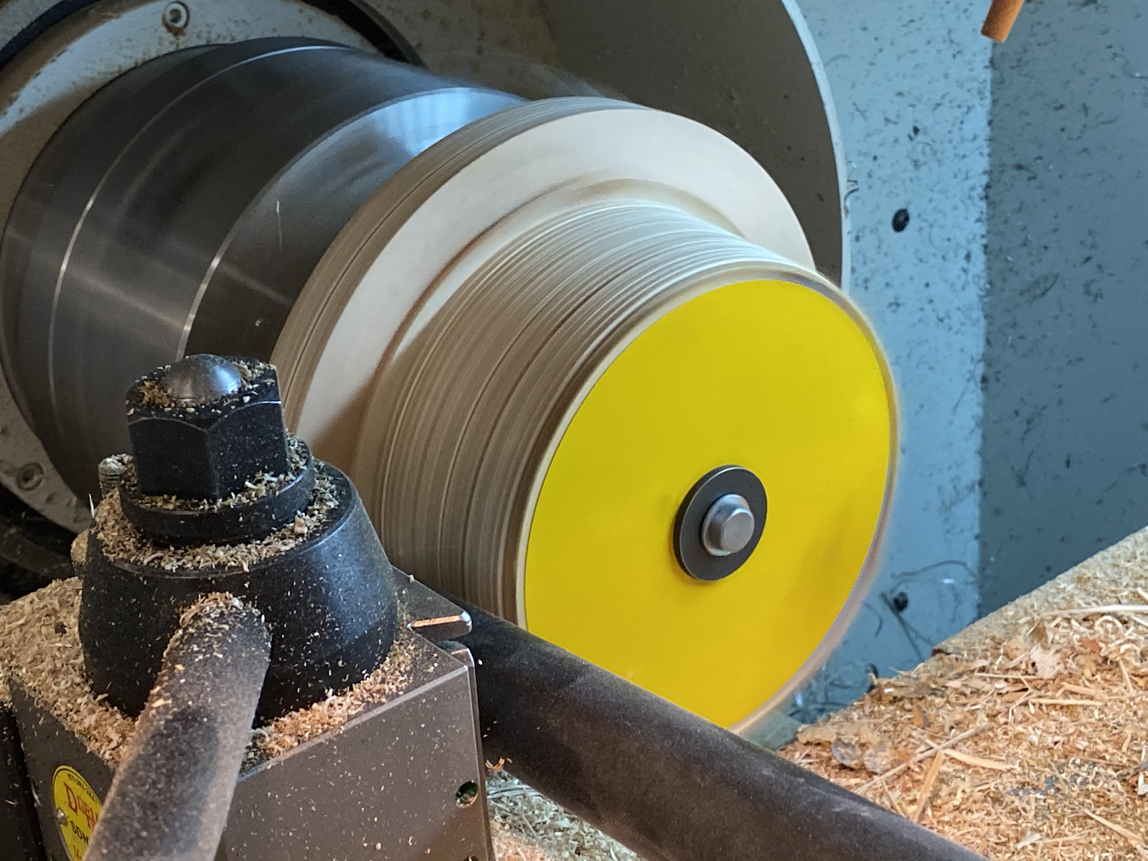
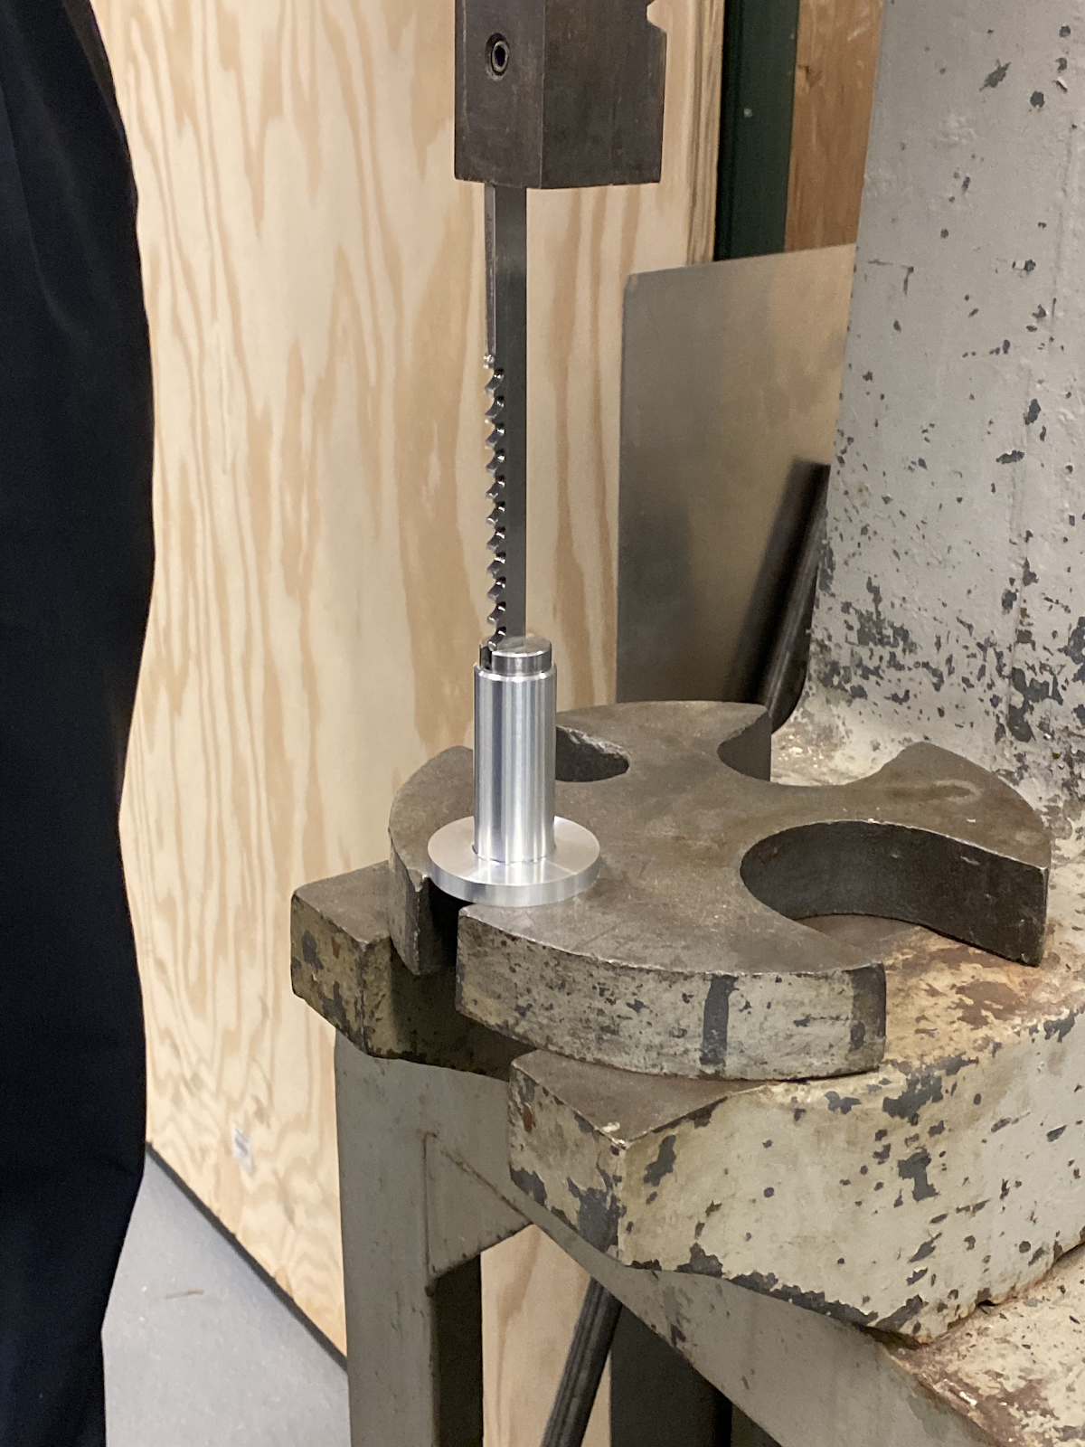
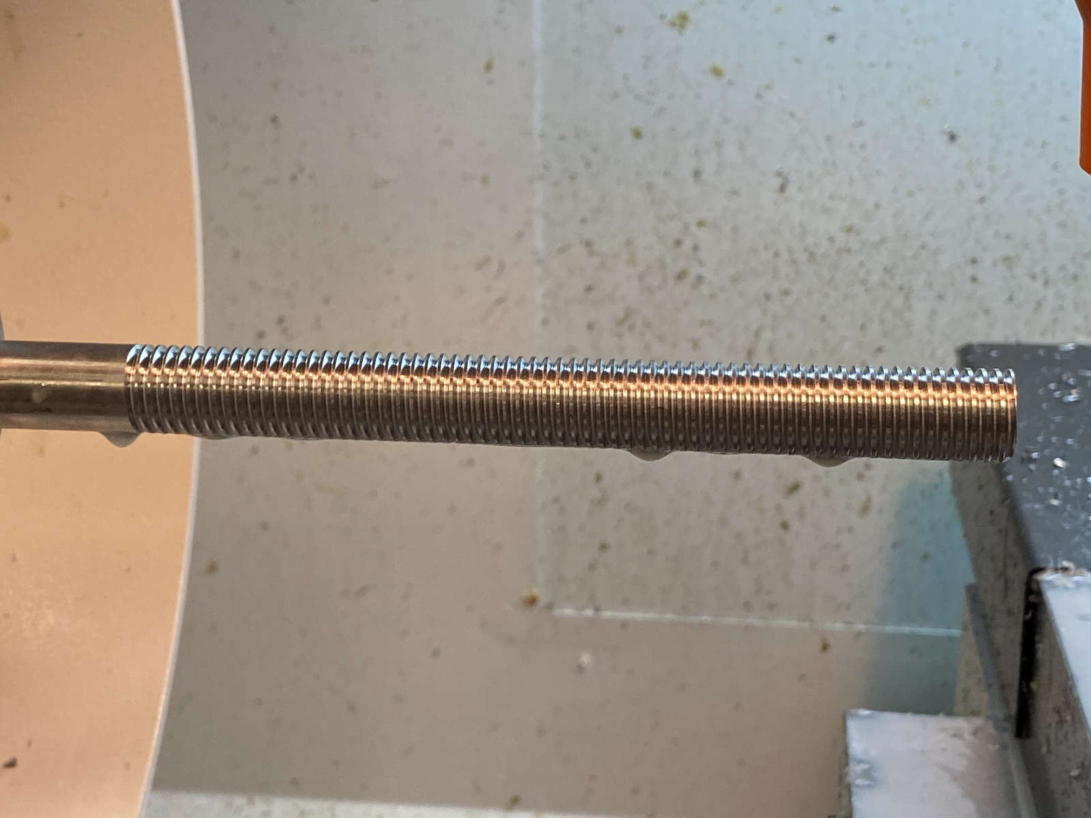
Fabrication
Lathe
Manually created features
Bore holes, turning diameter, cut parts from each other
Set references to be used in programs
Wrote programs to create more complicated features multiple times
Used broaching tool and press to make keyways
21

Slide 25
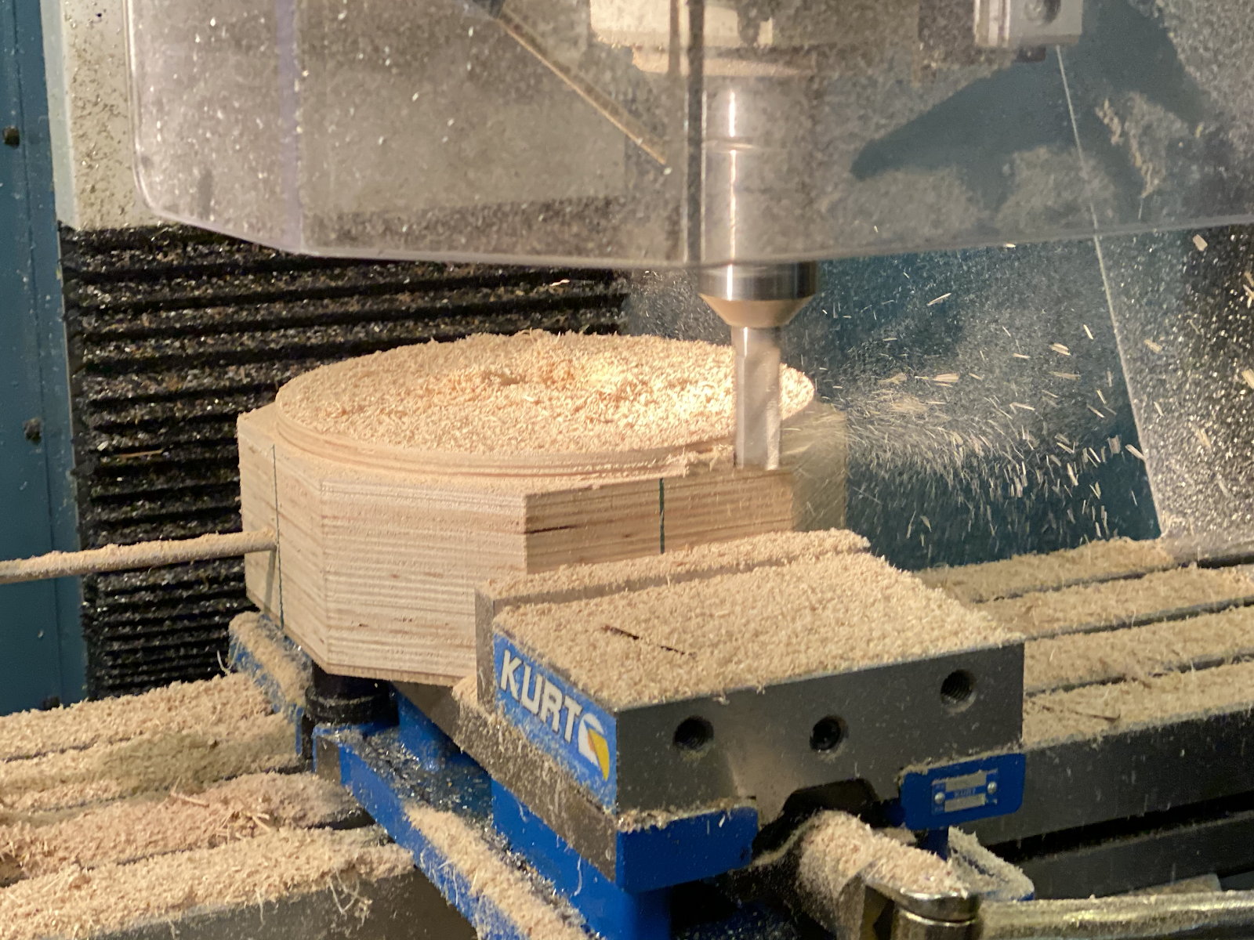
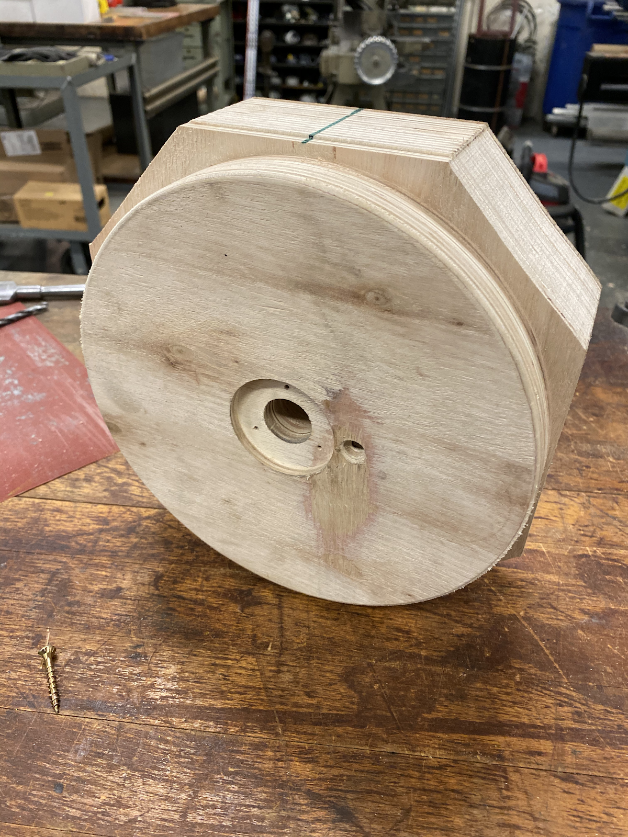
Fabrication
Milling Machine
Manually used machine to set references
Wrote a program to recreate the exact wheel part four times
22

Slide 26
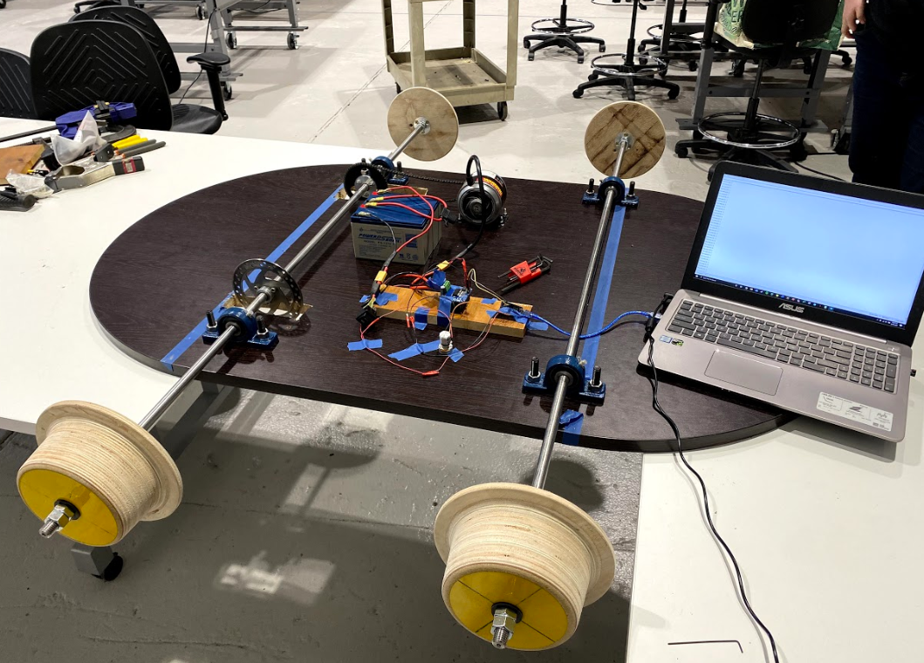
Testing
23

Slide 28
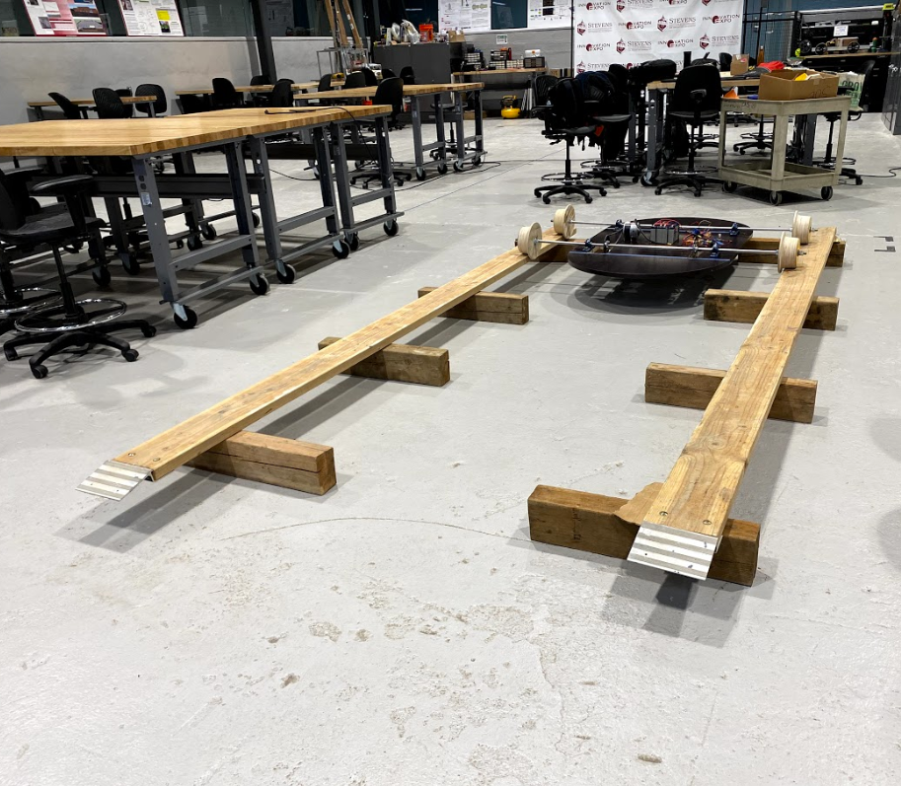
Testing
25

Slide 29
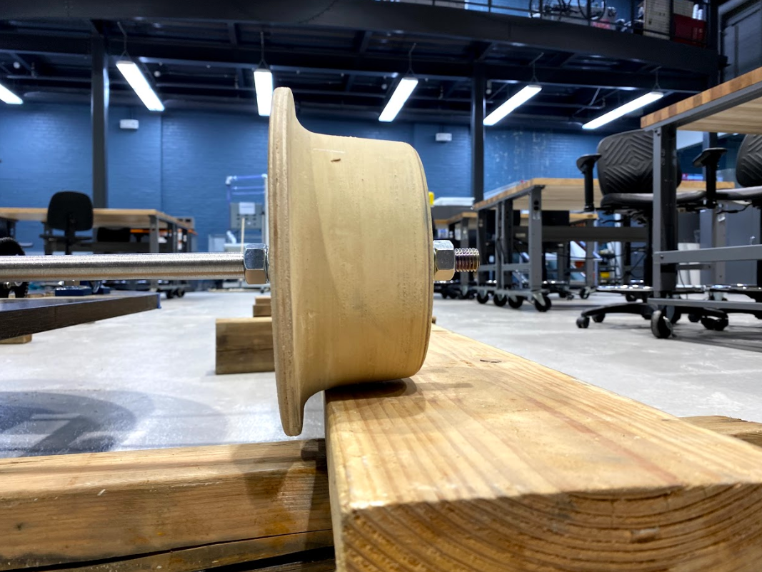
Testing
26

Slide 30
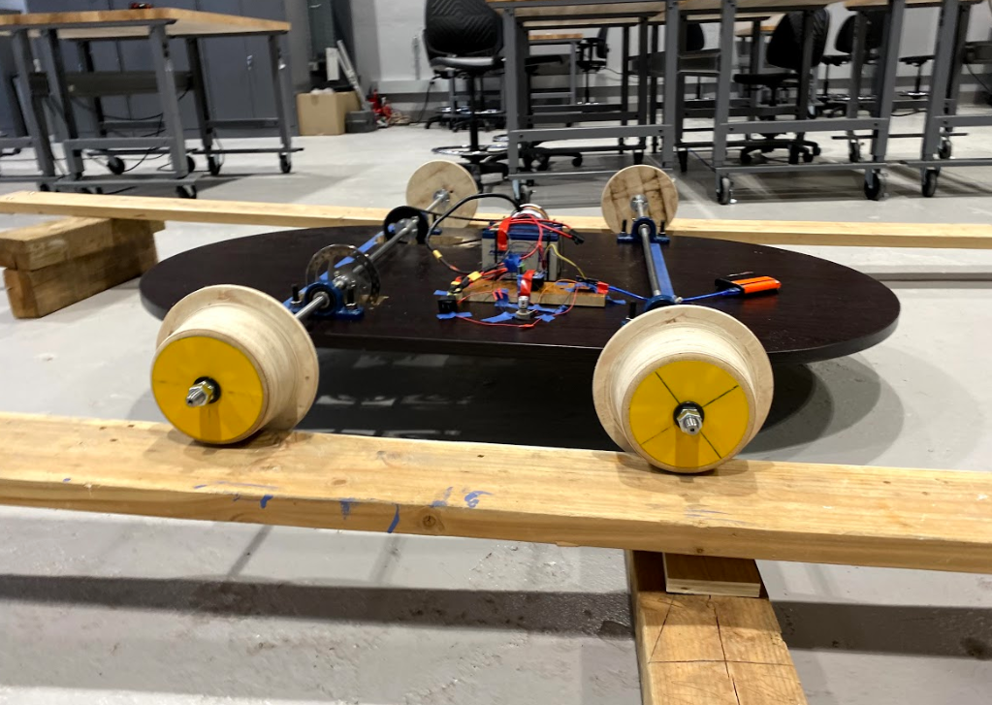
Testing
27

Slide 32
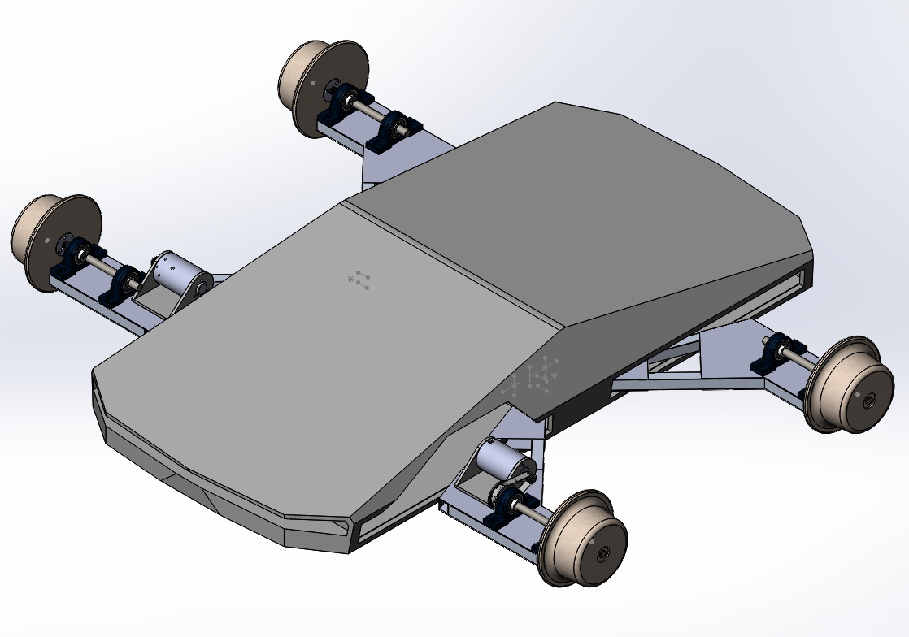
Beta Prototype
29

Slide 33
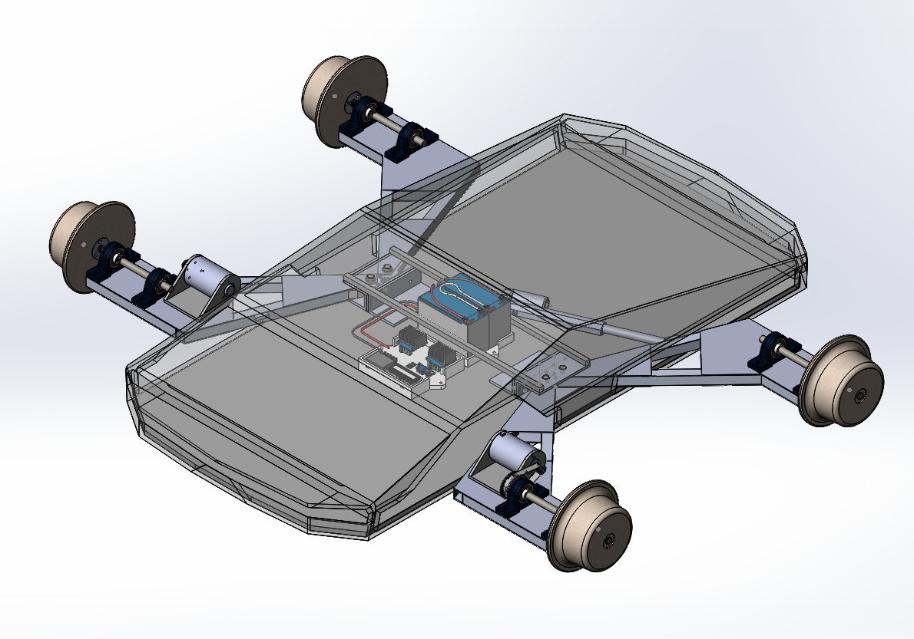
Beta Prototype
30

Slide 34
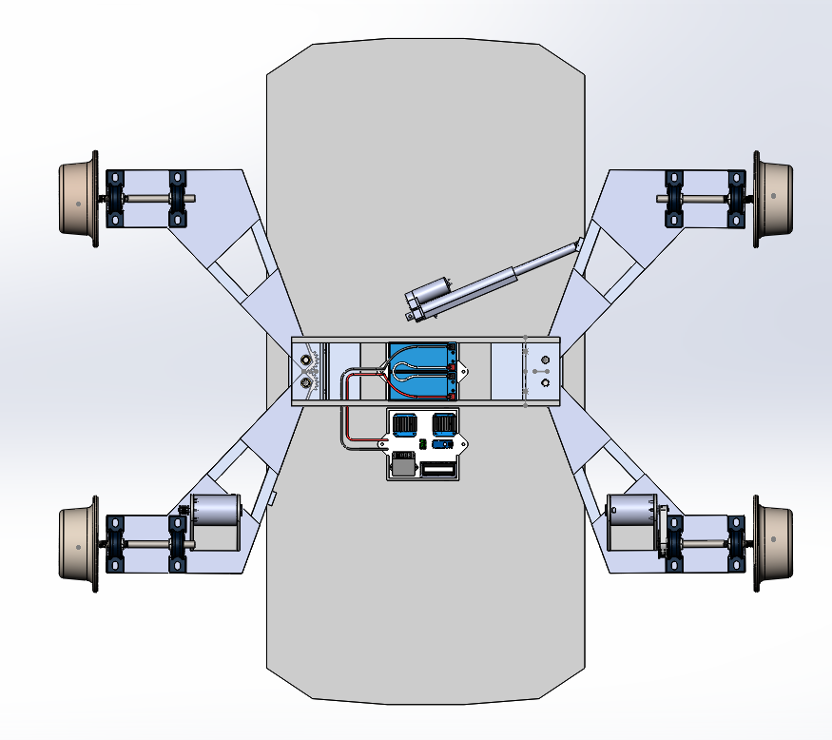
Beta Prototype
31

Slide 35
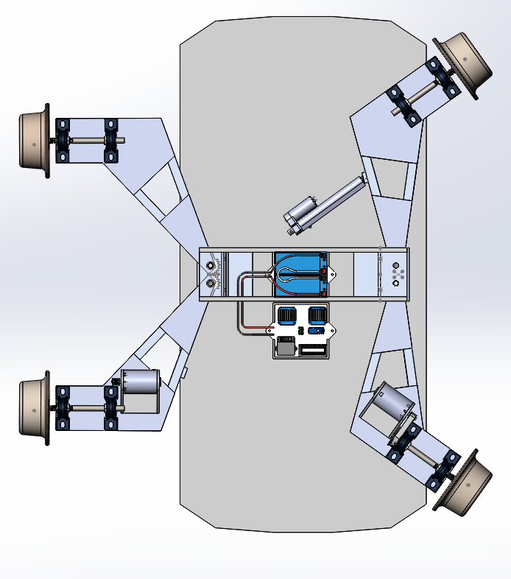
Beta Prototype
32

Slide 36
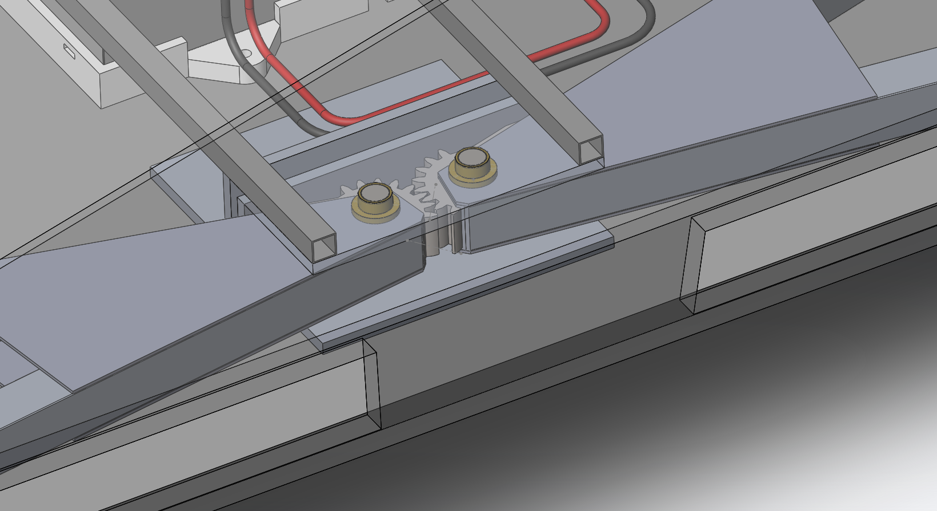
Beta Prototype
33

Slide 37
Moving Forward
4

Slide 38
Deliverables
Procure Remaining Beta Prototype Parts
Assemble Beta Prototype
Contact MTA for Testing Location
Testing and Analysis
Design Tweaking
35

Slide 39
Budget
Sensors and Electronics
Item | Price
Light Sensors | Donation
Gyro, Accelerometer, and Compass | $15.95
Time-Of-Flight Sensor (x3) | $25.47
Adafruit DataLogger Arduino Shield + Button Battery + Stacking Headers | $27.49
Arduino Mega 2560 Microcontroller Rev3 | $40.10
M12 12-Pole Cables (x2) | $72.00
Total: | $181.01
36

Slide 40
Budget
Drivetrain Parts
Item | Price
Rod (x2) | $26.50
Pillow Block Bearing (x4) | $22.58
12 V 7AH SLA Battery (x2) | $34.40
12 V Battery Charger | $9.99
Total | $93.47
Total Cost (Electrical + Mechanical): | $292.87
Remaining Budget: | $407.13
37

Slide 41
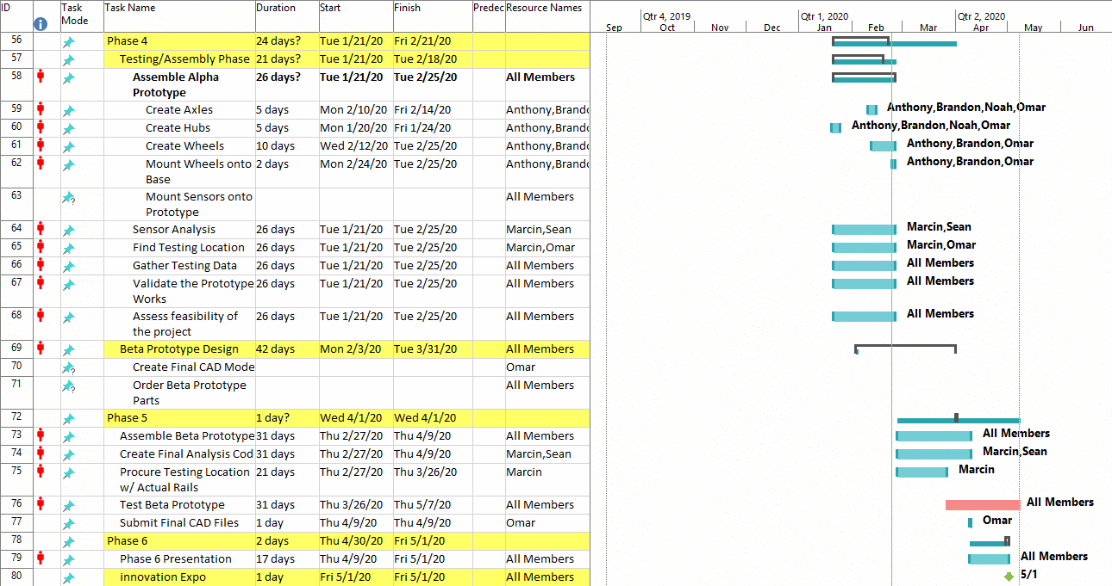
Timeline
38

Slide 42
Deliverables
Phase 5
Assemble Beta Prototype
Date: March 23, 2020 - March 30, 2020
Procure Testing location w/ MTA
Date: March 13, 2020
Test Beta Prototype
Date: March 30, 2020 - April 8, 2020
39

Slide 43
Appendix

Slide 44
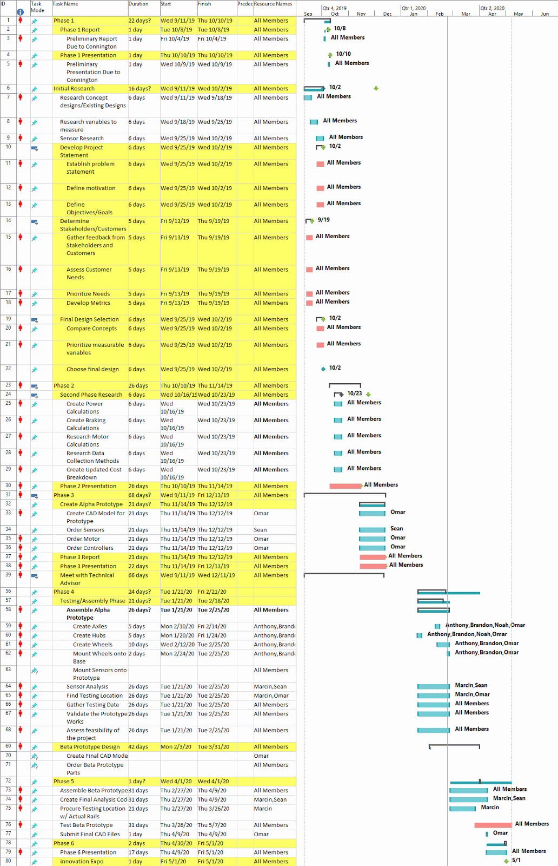
Gantt Chart

Slide 45
Gantt Chart

